Slide 1

הצהרה
שם הלקוח/חוקר: _____אלכס לבל_________________
אני ______אלכס לבל_______________________
מאשר שהתכנים שבפוסטר אינם מסווגים וידוע לי שהמכללה רשאית להציג את הפוסטר בתערוכות, בקטלוג פוסטרים ובכל פרסום אחר שתמצא לנכון.
חתימת מורשה חתימה מטעם הלקוח/החוקר: ____אלכס לבל__________
חותמת הלקוח: _________________ תאריך: __________04.06.2026____

Slide 2

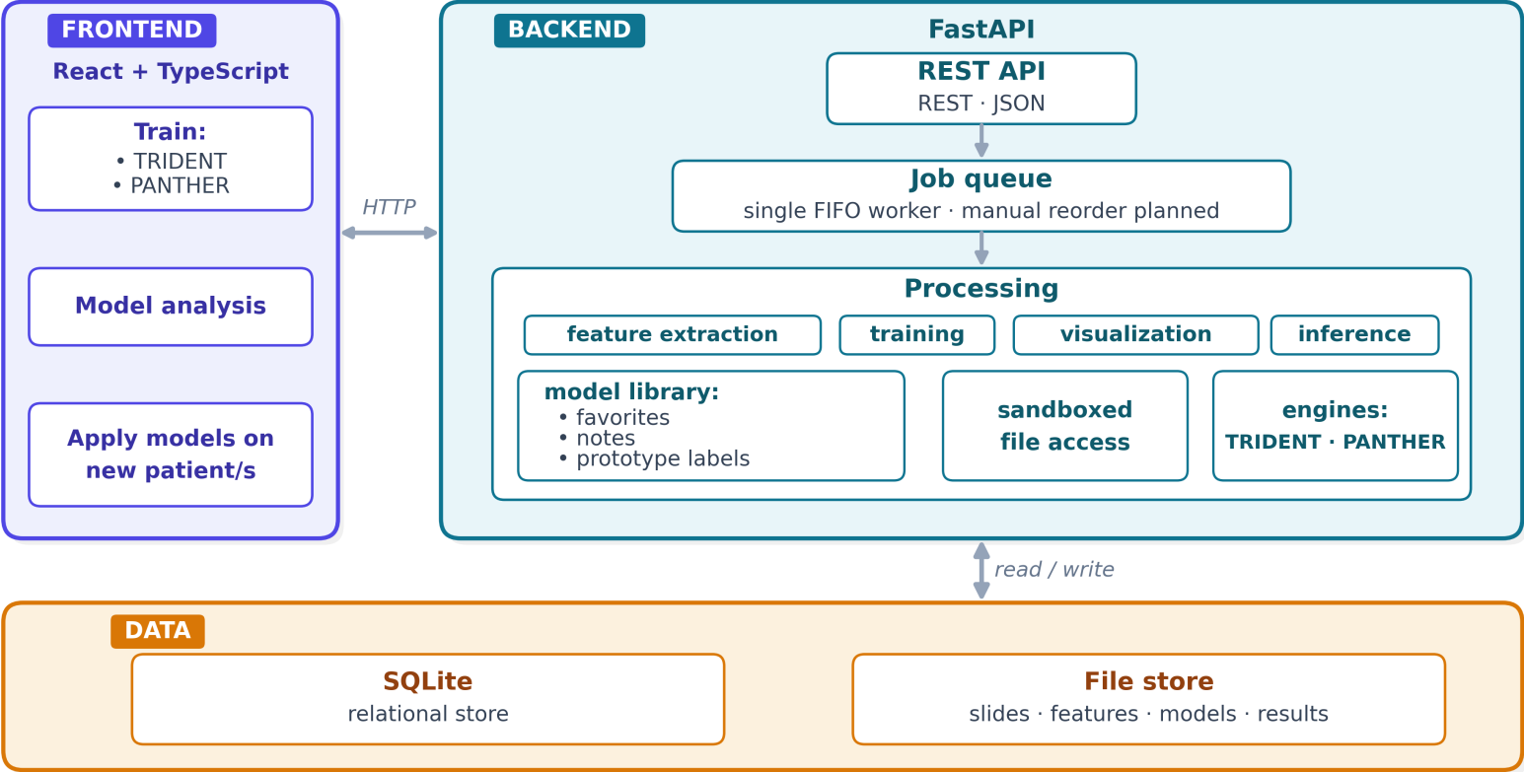
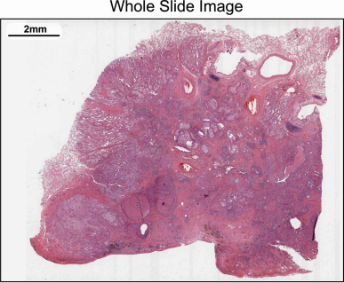

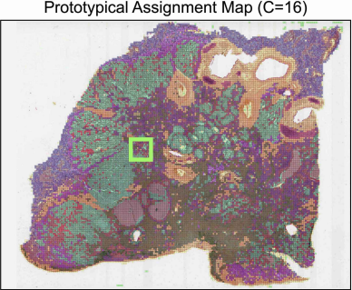
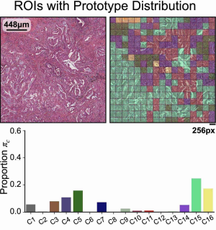
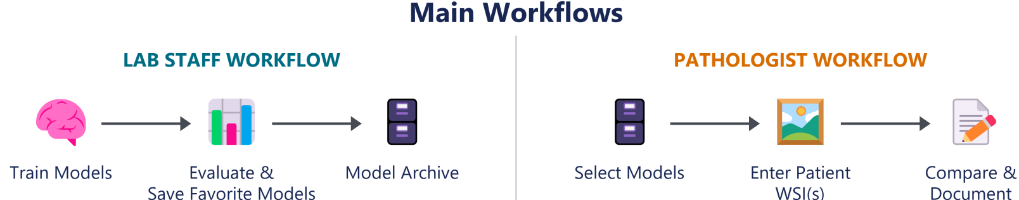
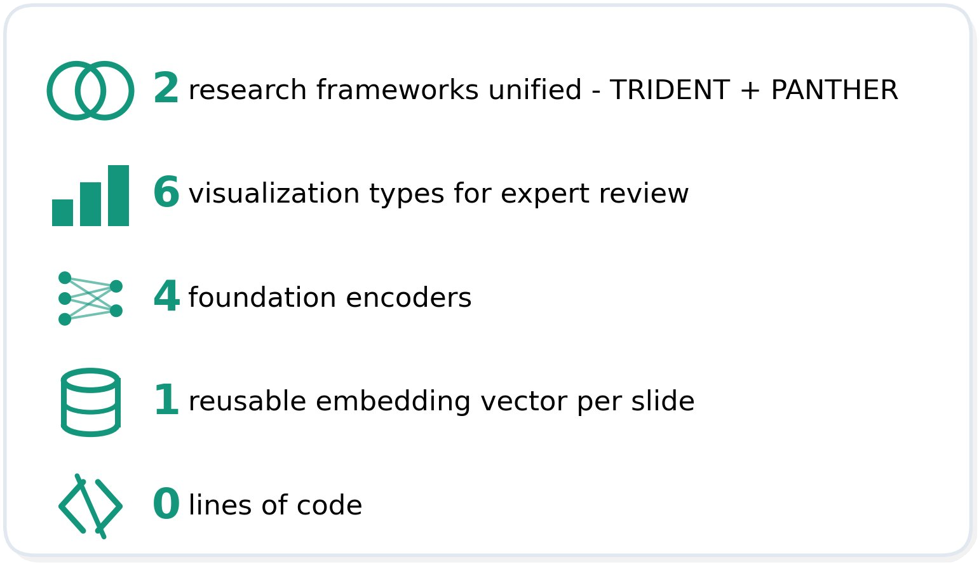
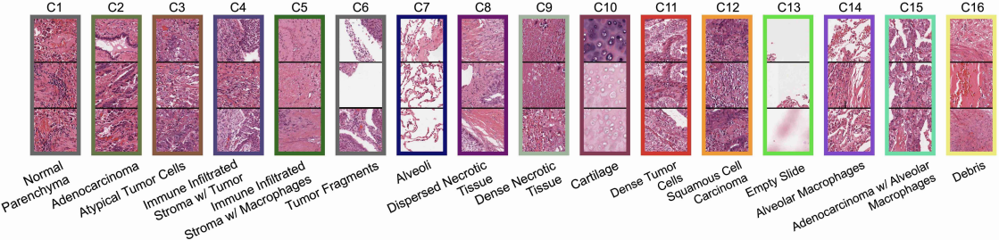

| Computer Science
Dolfin Varshev, Daniel Rubinstein, Shahar Ishay
Advisors: Dr. Alex Loebel, Dr. Sharon Yalov-Handzel
Client: Sheba Medical Center
Bagheera: Code‑Free Pathology AI, From Model Building to Patient Analysis
3. Architecture
1. Problem description
Massive data: Histopathology WSIs are gigapixel-scale - slow and costly to analyze.
Inefficient re-processing: The most expensive step - encoding the whole slide is recomputed from scratch for every new task.
No code‑free, shared workflow: Models are set up by hand, with no unified way to evaluate, compare, or document - lab knowledge isn't shared and results are re-examined.
Goal: eliminate coding · standardize workflow · share knowledge
2. The Solution
4. Engineering challenge
Bagheera turns a complex research pipeline into an intuitive, code‑free GUI - from model building to patient analysis.
Process once, reuse everywhere: Storing each slide's embedding after the first pass, so every later analysis reuses it.
Code‑free training: Button‑driven settings replace code, putting the whole lab on one standard.
Expert visual evaluation: Interactive tissue‑pattern views let laboratory staff flag favorite models.
Compare per patient: Run a new slide through several models, review model-by-model, pick the best.
Shared memory: Favorites, notes, and summaries stay attached to each model per run - so the next pathologist sees prior decisions and can add on them.
Benefits: no coding · cuts compute · collaborative documented decisions
Keeping every analysis resilient, so a single failed step never breaks the whole result.
Unifying two complex research frameworks - TRIDENT, PANTHER into a single automated, code‑free pipeline.
Guaranteeing every patient analysis runs with the exact settings as selected models were trained on.
Delivering interpretable, visual results for expert review.

